Slide 1
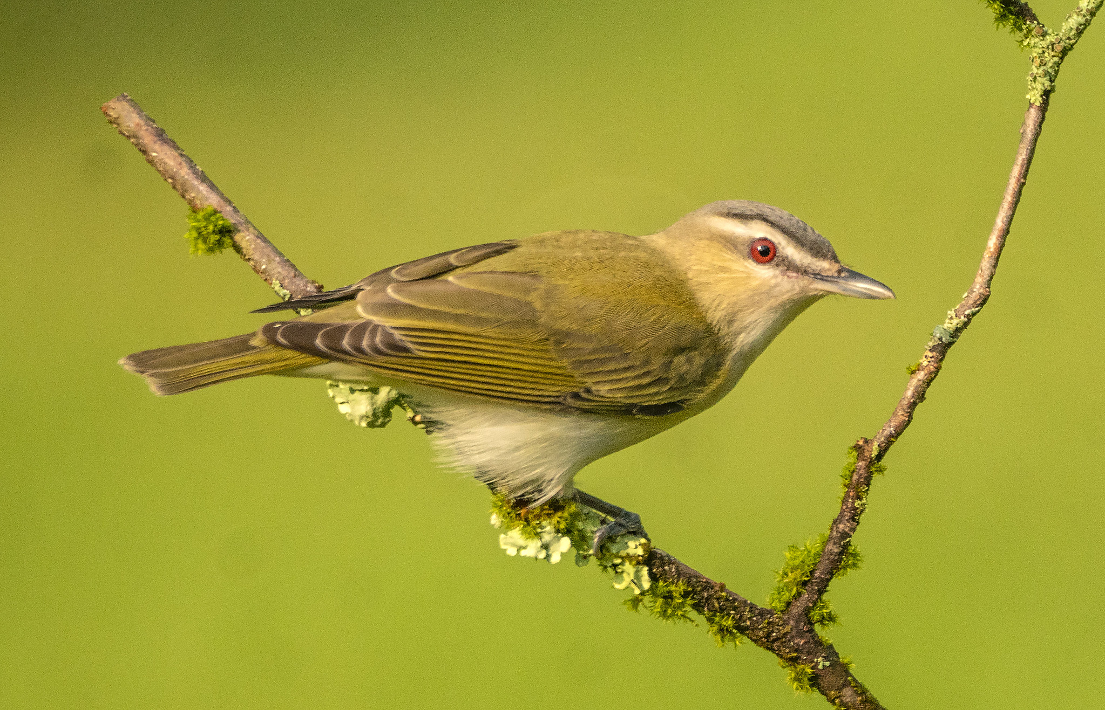
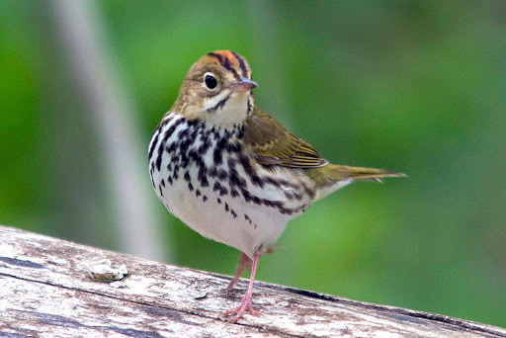
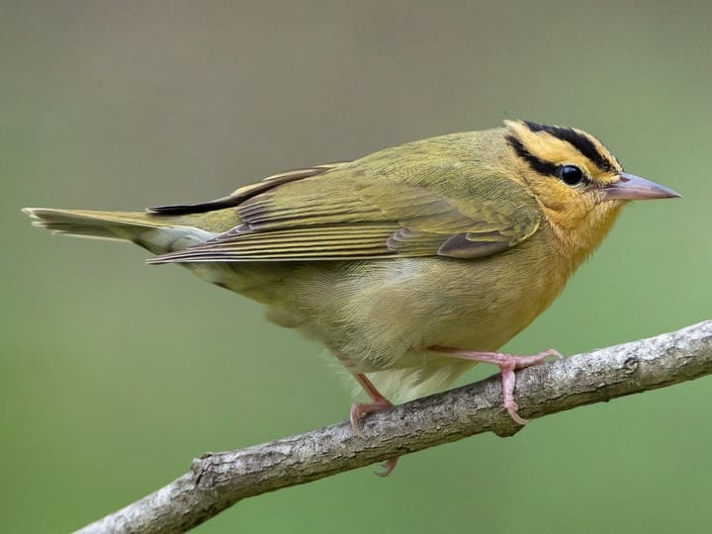
How does insect food quality for songbirds vary among tree species?
Research proposal and discussion for 2021 (and 2022) field season

Slide 2



Starting Summer 2021: Full time consulting data scientist on multiple projects

Slide 3
Big-picture goals
Complete publishable research that engages visitors, volunteers, and members of Great Hollow Nature Preserve
Collect data that can go towards federal grants with University collaborators
Generate some simple management recommendations for improving bird health in Connecticut forests

Slide 4
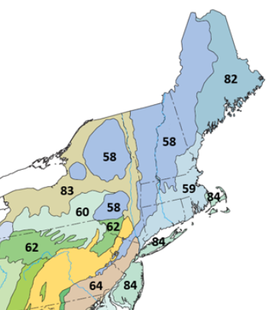
Research goal 1
What insects are birds preferentially consuming in Northeastern Highlands ecoregion?

Slide 5
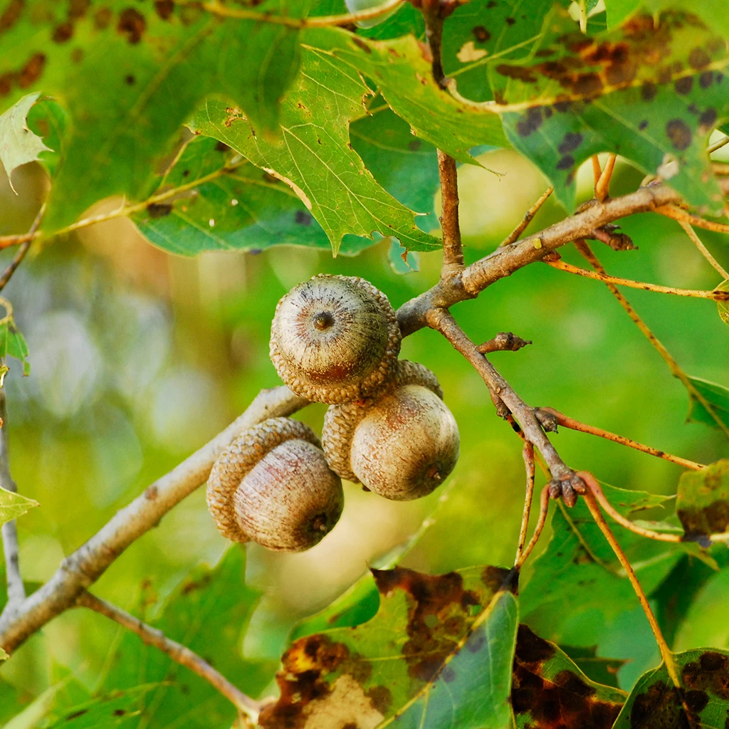
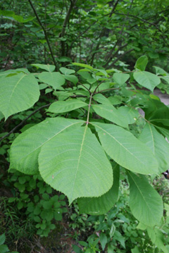
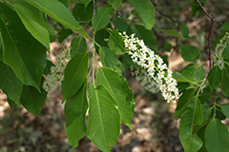
Research goal 2
How does nutrient composition (lipid/protein/other) of arthropod communities vary among common host trees?

Slide 6
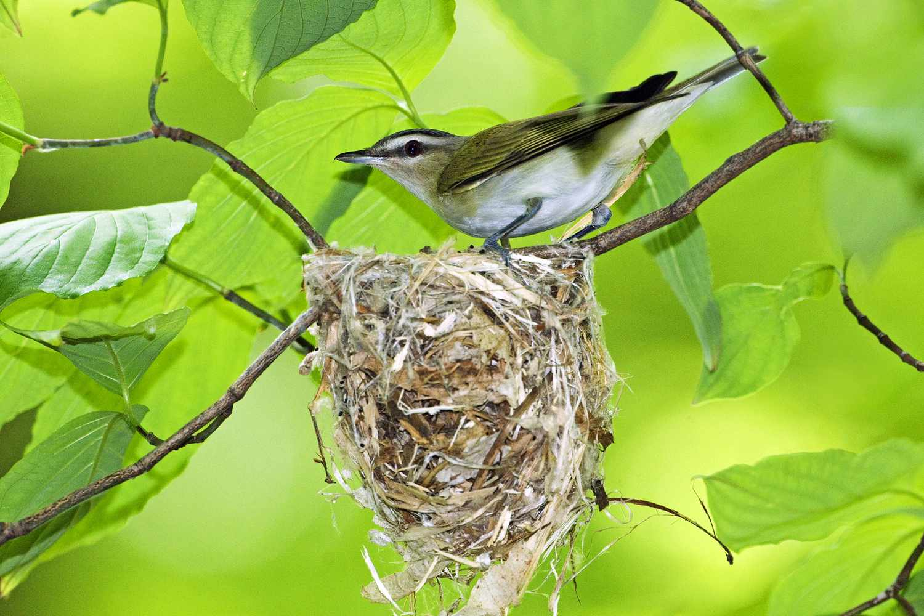
Research goal 3
What is the impact of this “indirect nutritional quality” on nesting songbirds?

Slide 7
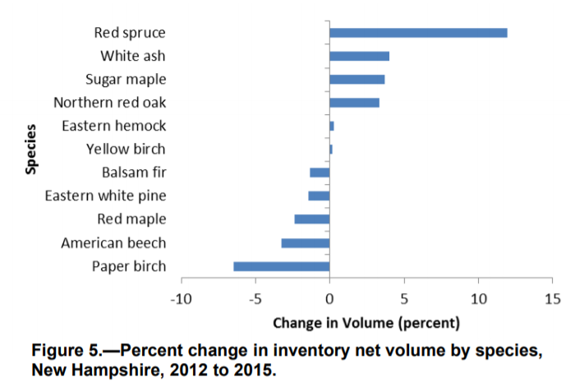
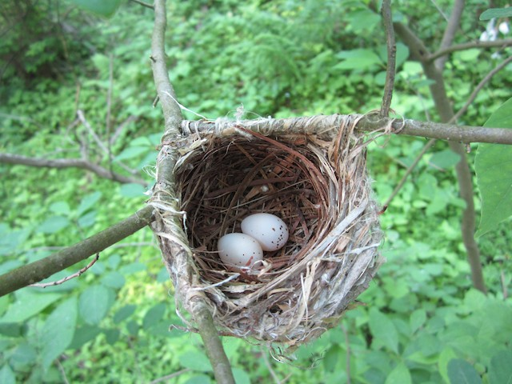
There is plenty of research demonstrating how forest composition impacts breeding bird success

Slide 8
Food availability is considered an important mechanism, but the quality of insect prey has barely been examined at all

Slide 9
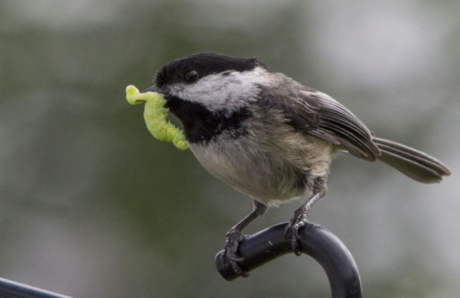
While not the only food source, foliage-feeding insects (primarily caterpillars) are especially important for nesting songbirds

Slide 10
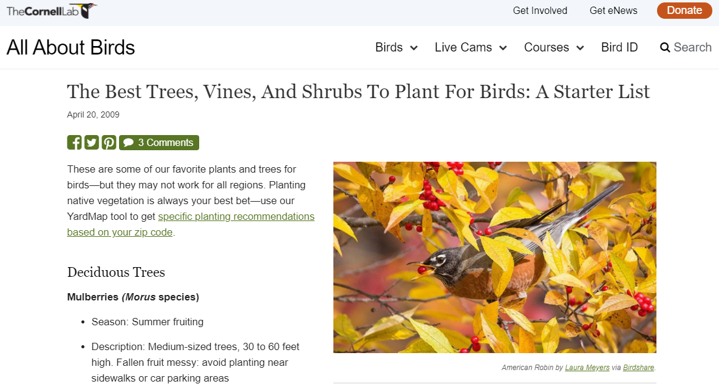
Everyday folks frequently ask what trees they should plant in their yard for birds, but there is very little data to support recommendations

Slide 11
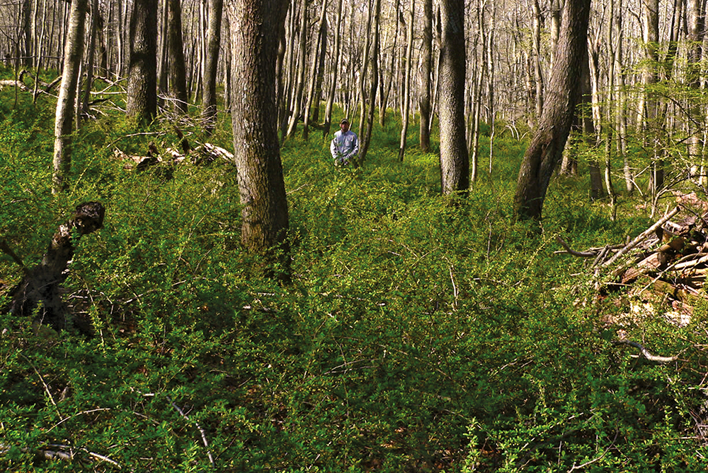
Invasive shrubs are problematic in local forests (Barberry, Rose, etc.) and can displace understory trees and shrubs

Slide 12
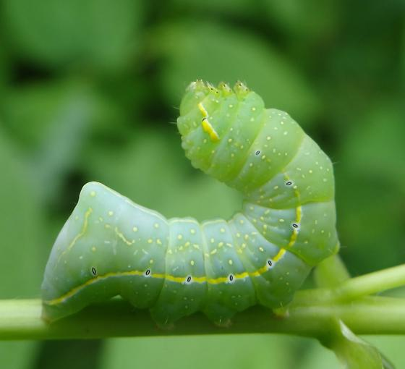
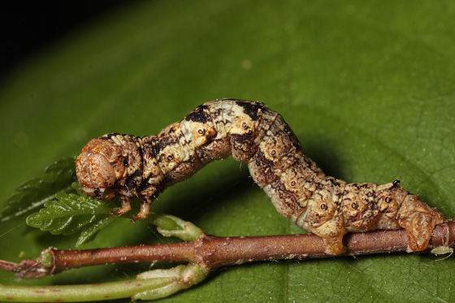
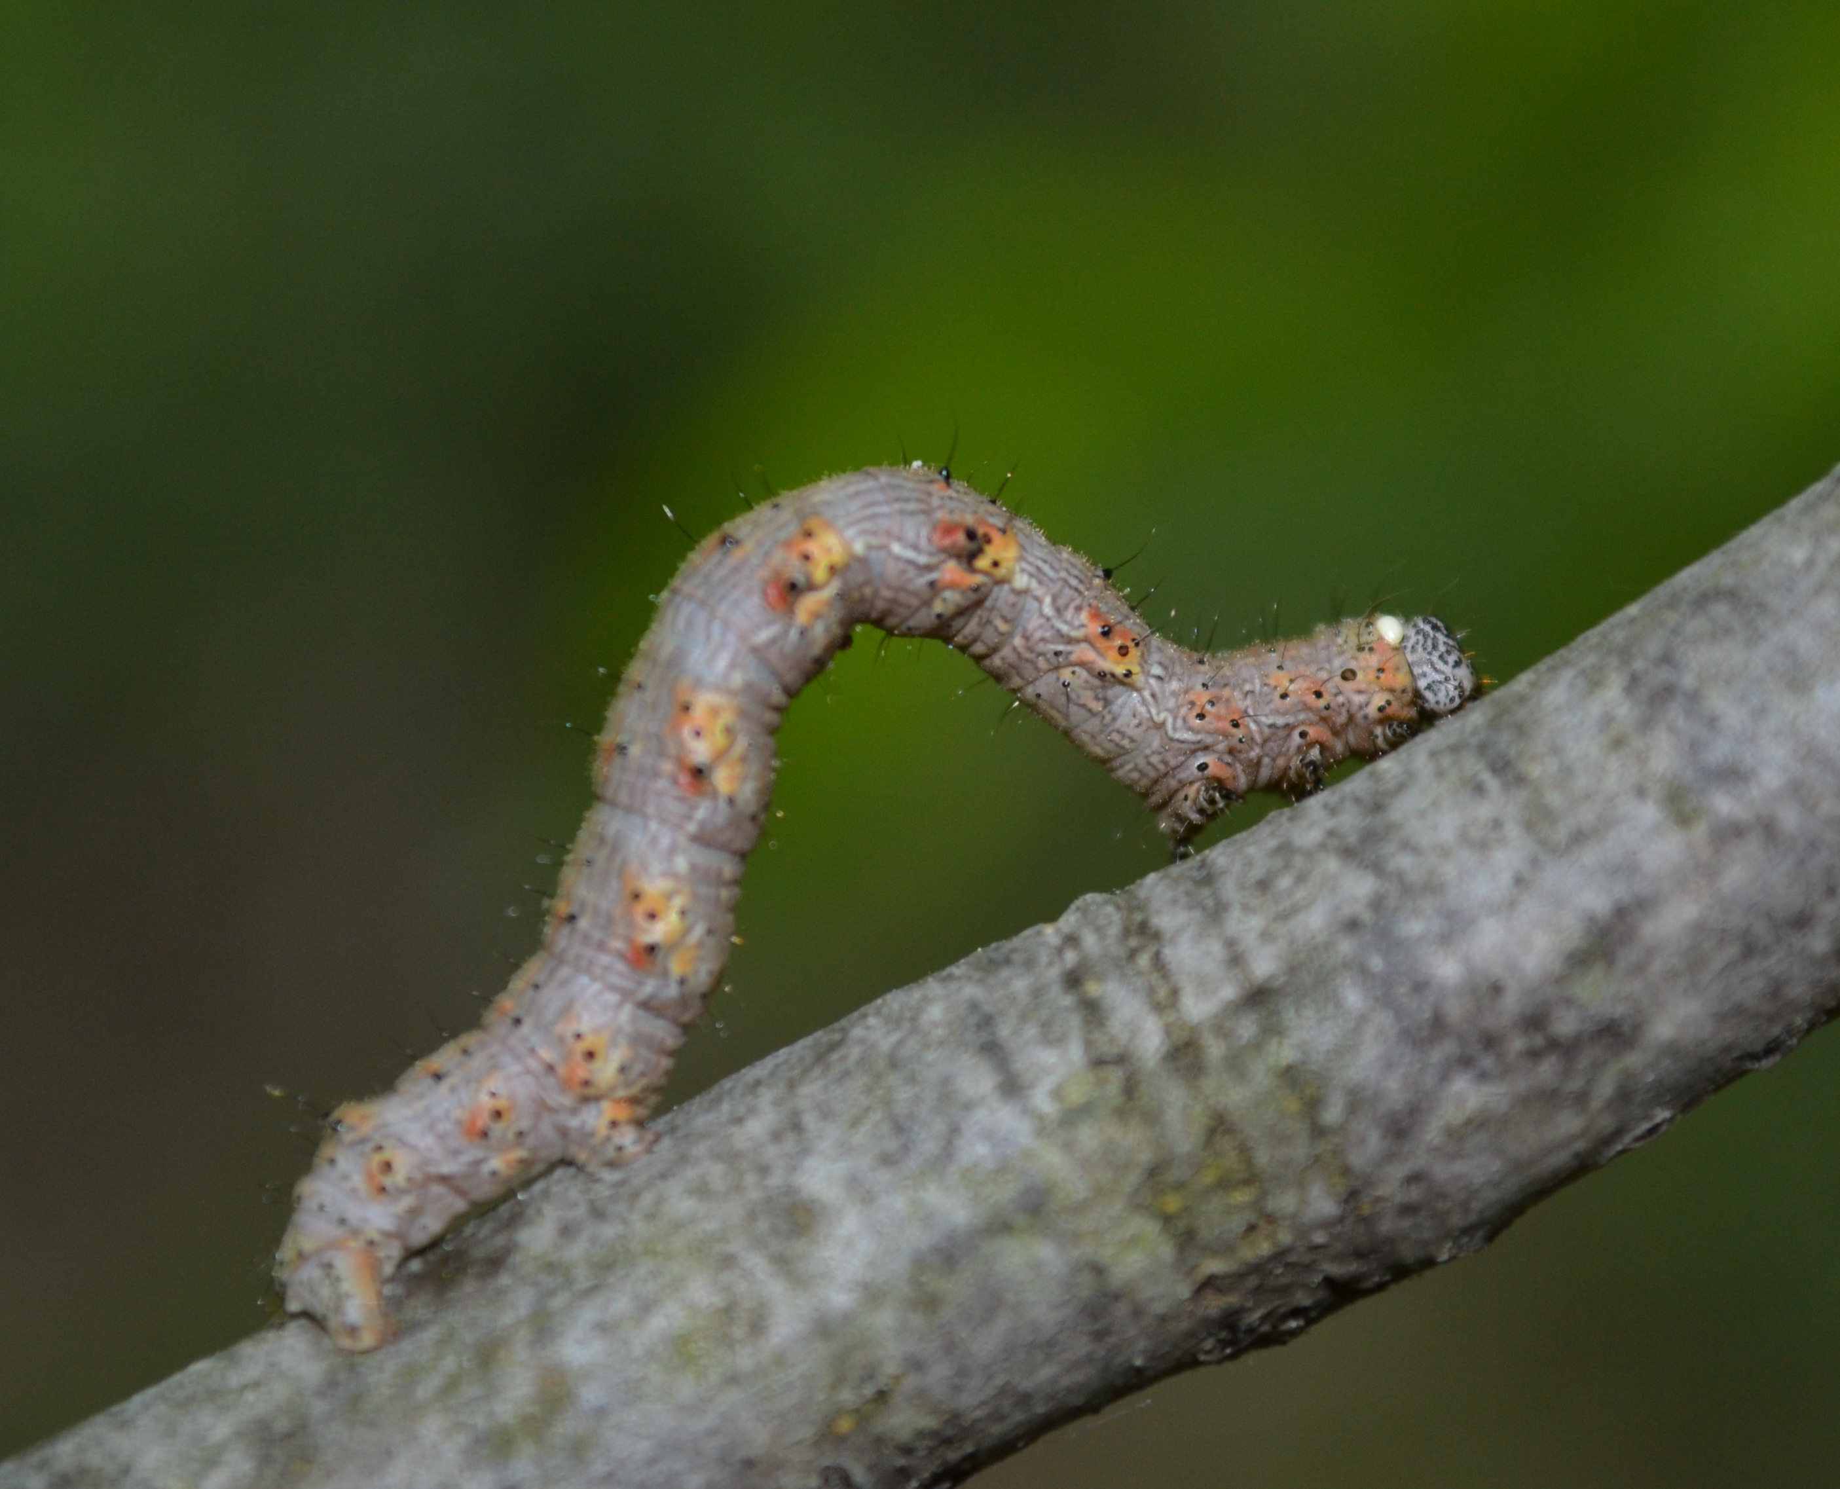
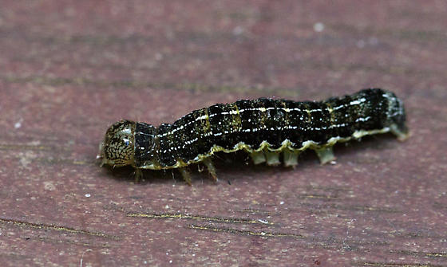
Hamburgers of the forest hypothesis: Tri-trophic interactions and caterpillar food quality for songbirds
Migratory insectivores
Forest caterpillars /
Forest arthropods
Host trees
Maple
Oak
Barberry
Rose

Slide 13
Red Maple
Cherry
Red Oak
Birch
Euonymus
Predation effect strength
Barberry
Autumn olive
Buckthorn
Mean lipid content of host plant species
(Also tested at the plot-level)

Slide 14
Red Maple
Cherry
Red Oak
Birch
Euonymus
Predation effect strength
Barberry
Autumn olive
Honeysuckle
Mean lipid content of host plant species
(Also tested at the plot-level)

Slide 15
Hypotheses / predictions
Overall “indirect nutritional quality” will vary among sites and host-tree species
Host-tree species known to be of high quality to generalist caterpillars will also be of high quality for birds
Sites dominated by these same host trees will have birds with better indicators of fat/protein content in diet
Arthropod lipid/fat content will scale with biomass, but this will be modified by site or tree species effects

Slide 16
Experimental design is a bird-focused modification to Singer lab forest caterpillar projects
Experimental setup occurs before Vireo and Ovenbird reach peak activity levels (very early May)
Shorter sampling period with more frequent sampling events (3)
Plots are based on potential foraging territory size for insectivorous birds
Insects (mostly caterpillars) preserved for later nutritional analysis instead of reared

Slide 17
Experimental overview
Setup 18 plots among 3 forests (Great Hollow, Pawling, Deer Pond) starting in early May
9 paired exclusions (+bird/-bird) among at most three species per plot
Three sampling events to ensure enough insect biomass is collected
Primary data collected: caterpillar abundance, foliage-foraging arthropod biomass, protein/lipid content of arthropods, bird plot counts
Opportunistic data collected: Caterpillar species IDs, protein/lipid content of bird blood samples

Slide 18
Staff, volunteers, and resources
Three full time folks (Wales as postdoc lead, two paid summer interns)
Two folks who can help during crunch time (Chad and Rob)
Volunteers and staff collaborators through Audubon and Great Hollow
These folks can help scouting for sites and trees, bird plot counts
Lab space at Great Hollow to process samples and nearby collaborators to run some protein/lipid analyses afterwards
Singer lab for a fun field day?

Slide 19
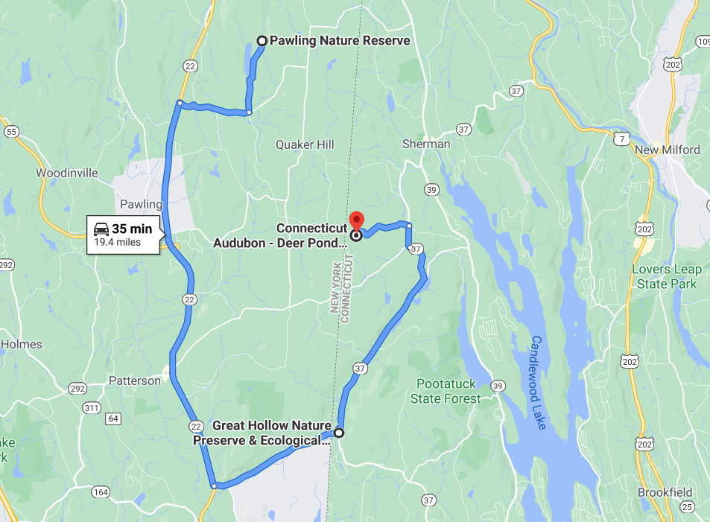
Three forest sites straddle the CT-NY border

Slide 20
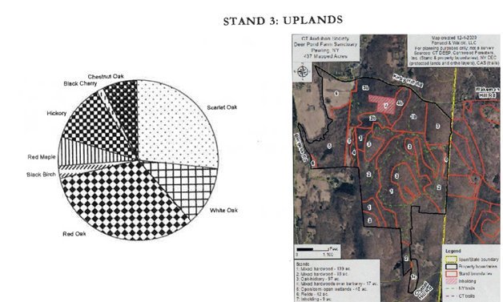
As nature preserves, each forest has some baseline information on tree stand structure or bird communities

Slide 21
Three example plots (no invasive plants)
Plot A
Plot B
Plot C
Oak
Oak
Birch
Birch
Hickory
Birch
Birch
Hickory
Maple
Hickory
Maple
Maple
Hickory
Hickory
Hickory
Oak
Oak
Oak
Maple
Oak
Birch
Birch
Oak
Oak
Bird exclusion

Slide 22
Plot types with invasive plants
Bird exclusion
Exotic species
Invaded plots
Non-invaded plots
Oak
Oak
Oak
Oak
Barberry
Maple
Maple
Maple
Barberry
Maple
Maple
Barberry
Maple
Barberry
Maple
Maple
Barberry
Oak
Oak
Maple
Oak
Oak
Oak
Oak
Maple
Barberry

Slide 23
Unanswered questions in terms of experimental design
What host plant species to include in the bird exclusion experiment? The same as Wesleyan forest caterpillar experiments?
How do we incorporate other insect traits (defenses) that impact nutritional quality into the analysis?
Can we find enough small trees and sites in a new sampling area?

Slide 24
Old slides

Slide 25
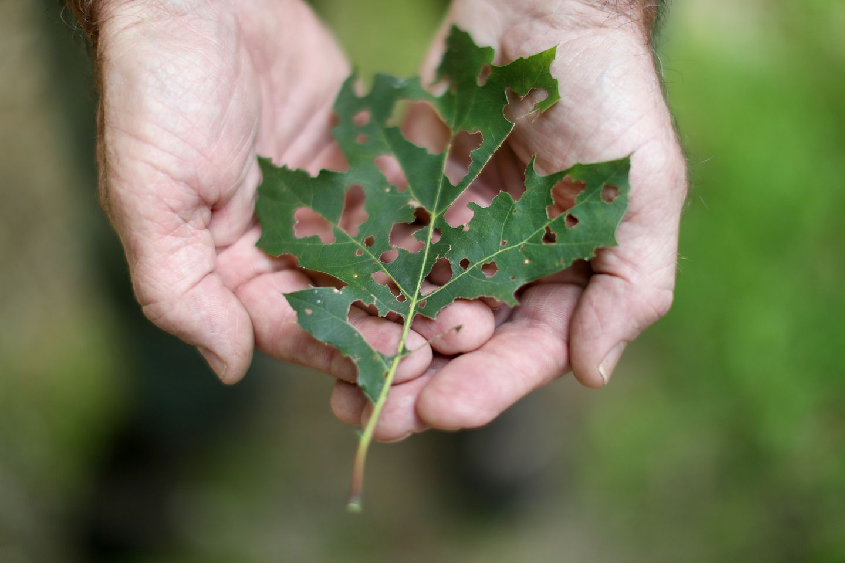
Habitat quality for birds and bird diversity mediates caterpillar suppression
Indirect effect
Weak direct effect
Strong direct effect
High quality habitat or birds
Low quality habitat for birds
Low quality habitat for birds and caterpillars

Slide 26
Example prediction 1: Sites with more Amphipyra caterpillars are associated with well-fed ovenbirds

Slide 27
Example prediction 1: Hickory and cherry are abundant and there aren’t many invasive shrubs

Slide 28
Example prediction 2: Sites with mostly Phigalea on oaks have birds with poorer diet
Red oak is the only dominant native woody plant at that site

Slide 29
Example prediction 3:
We sample lots of bird data and caterpillar data
There a correlation between caterpillar species composition and bird health
This is explained by forest composition indirectly

